Slide 1
Aciurina

Slide 2
Stacks - denovo
96 initial samples
Ran with 4 different parameters
Parameters chosen: m5 M3 n3
Filtered using SNPfiltR
hard filter to minimum depth of 5, and minimum genotype quality of 30
Filter by the max depth cutoff of 100
3 samples (opaca) above a 0.6 missing data not removed for now
Other SNPfiltR cutoffs done
Processed variant: from 26023 to 22057
96 final samples

Slide 3
VCF tools
Variant missingness:
Missingness on a per-site basis. This is a measure of how many individuals lack a genotype at a call site.
Typically, missingness of 75-95% is used.

Slide 4
VCF tools
Mean depth per site averaged across all individuals.
- the number of reads that have mapped to this position (coverage)
- the more reads that cover a site, the higher confidence our basecall is.

Slide 5
VCF tools
Proportion of missing data per individual:
Missingness on a per-individual basis = proportion of missing data per individual

Slide 6
VCF tools
Mean depth per individual

Slide 7
VCF tools
Minor allele frequency

Slide 8
Missingness and depth per population

Slide 9
Missingness per indivicual

Slide 10
all

Slide 11
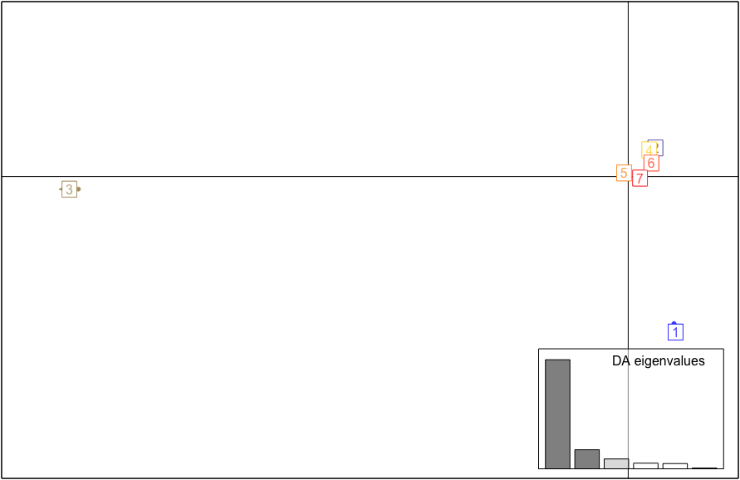
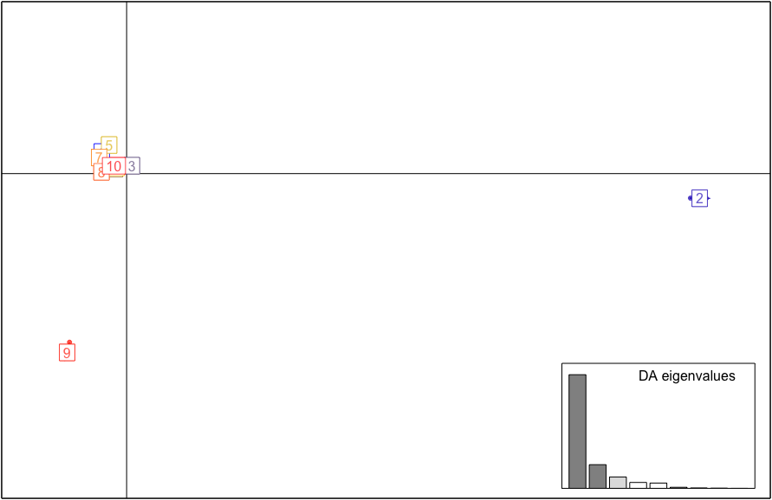
DAPC
1 | Marshmallow
2 | Opaca
3 | Notata
4 | NM Cotton
5 | Utah (S & G) + Reno (S & SH)
6 | CO, UT, MT Cotton
7 | NM + CO smooths
8 | Moab G
9 | Reno
10 | CO F
1 | Reno
2 | NM smooths
3 | Opaca
4 | Utah (S & G) + Reno (S & SH)
5 | Notata
6 | Marshmallow
7 | F & C

Slide 12
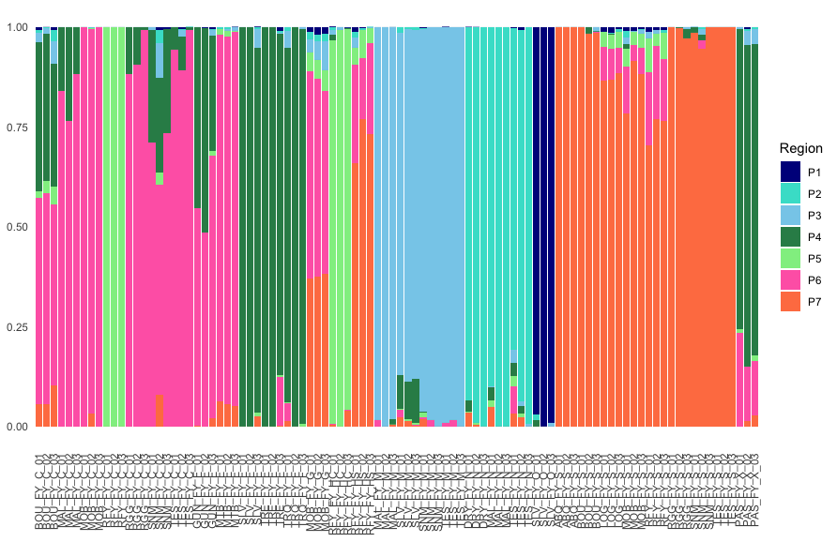
P7

Slide 13
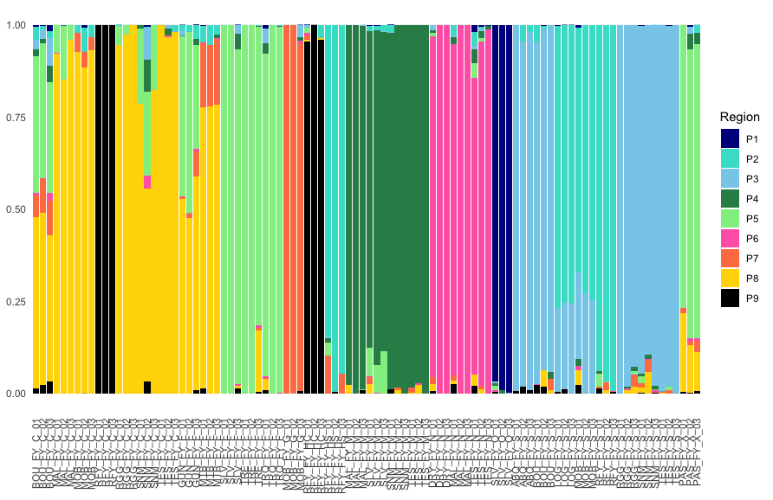
P9

Slide 14
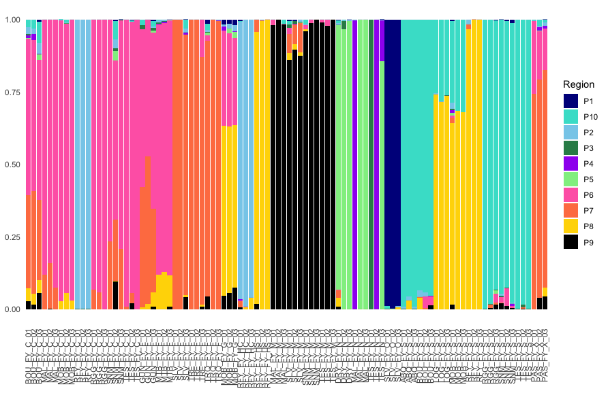
P10

Slide 15
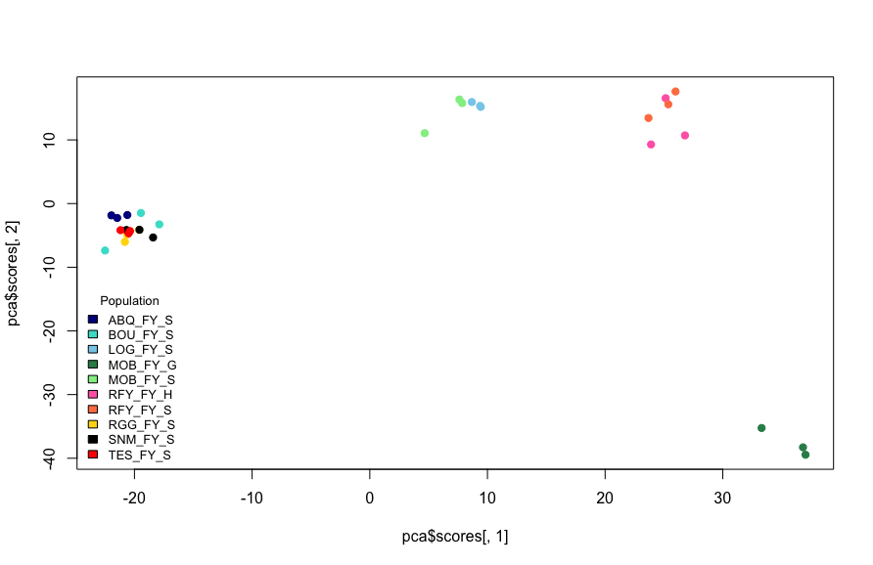
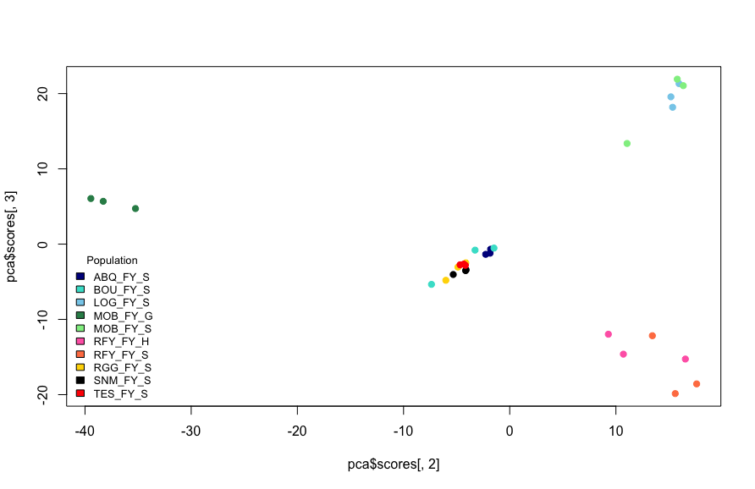
Smooth
Processed variant: 52170
- Smooth - Goober

Slide 16
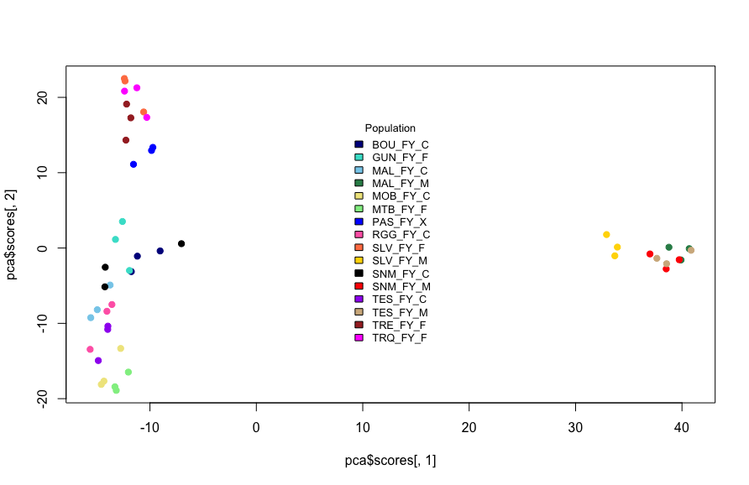
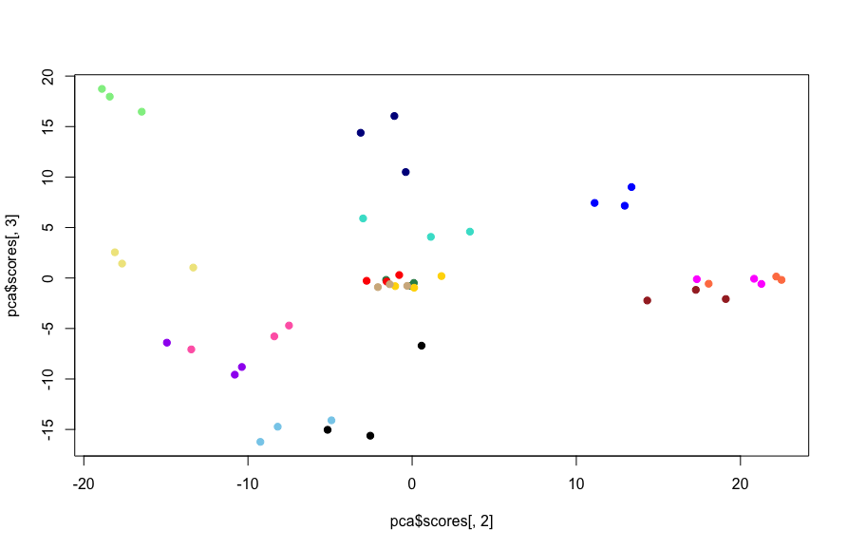
MFC
Processed variant: 41628
- Marshmallow - Finnial - Cotton

Slide 17
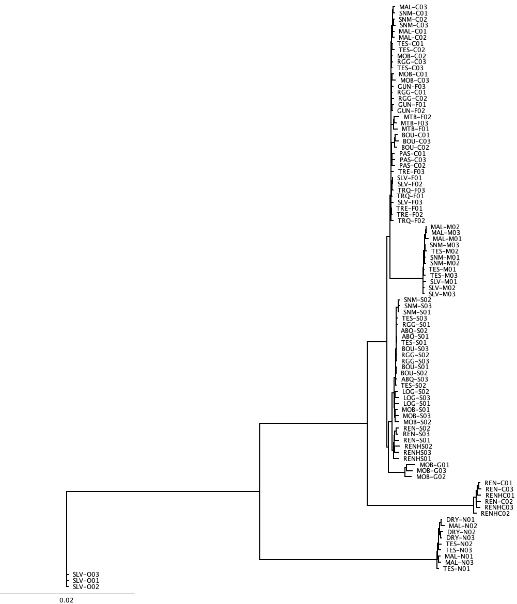
Fly
cotton/finial
IQTree
TVMe+ASC+R3 (AIC) and 1000 bootstrap 1000 alrt
marshmallow
smooth
goober
cotton
notata
opaca

Slide 18
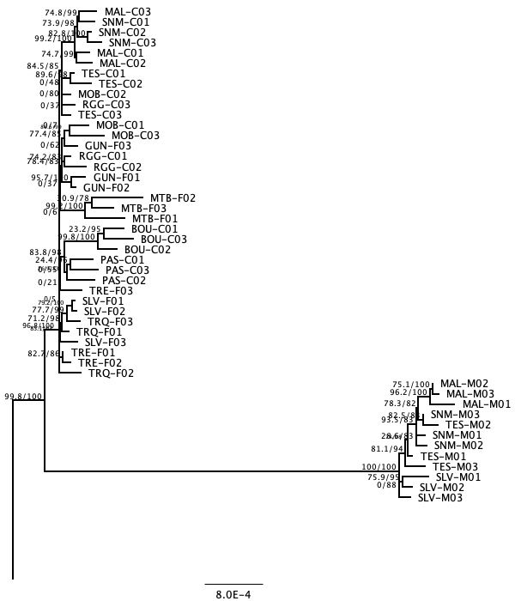
Fly
cotton/finial
marshmallow

Slide 19
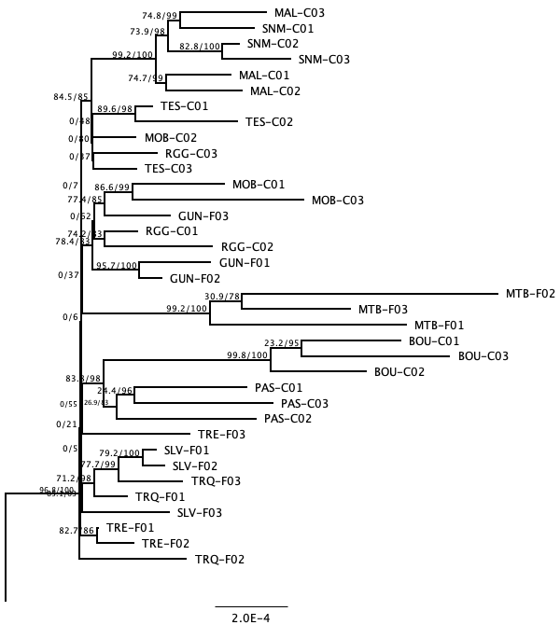
Fly
cotton/finial

Slide 20
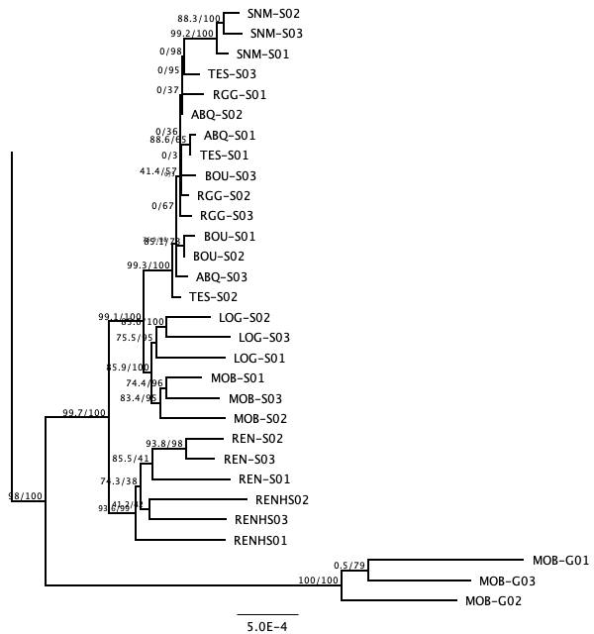
Fly
smooth
goober

Slide 21
Rabbitbrush

Slide 22
Initial denovo
198 initial samples
Ran with 4 different parameters
Only one finished running: m7 M3 n3
Variant count: 534532

Slide 23
VCF tools Stacks
Variant missingness:
Missingness on a per-site basis. This is a measure of how many individuals lack a genotype at a call site.
Typically, missingness of 75-95% is used.

Slide 24
VCF tools Stacks
Mean depth per site averaged across all individuals.
- the number of reads that have mapped to this position (coverage)
- the more reads that cover a site, the higher confidence our basecall is.

Slide 25
VCF tools Stacks
Proportion of missing data per individual:
Missingness on a per-individual basis = proportion of missing data per individual

Slide 26
VCF tools Stack
Mean depth per individual

Slide 27
VCF tools Stacks
Minor allele frequency

Slide 31
.50 cutoff missing data in each sample

Slide 32
Ran using 3 different methods
Stacks using 6 different parameters – reduced sample set
Stacks using reference based using Erigeron canadensis
Ipyrad

Slide 33
Stacks using 6 different parameters – reduced sample set
198 initial samples
Reduced dataset (5 samples per phenotype) = 27 initial samples (S, F, C, M, N)
SNPfilrtR
hard filter to minimum depth of 5, minimum genotype quality of 30
max depth cutoff of 100
missing data in each sample = .75
variant count: 203993
variant count after filtering: 11822

Slide 34
VCF tools Stacks using 6 different parameters
Variant missingness:
Missingness on a per-site basis. This is a measure of how many individuals lack a genotype at a call site.
Typically, missingness of 75-95% is used.

Slide 35
VCF tools Stacks using 6 different parameters
Mean depth per site averaged across all individuals.
- the number of reads that have mapped to this position (coverage)
- the more reads that cover a site, the higher confidence our basecall is.

Slide 36
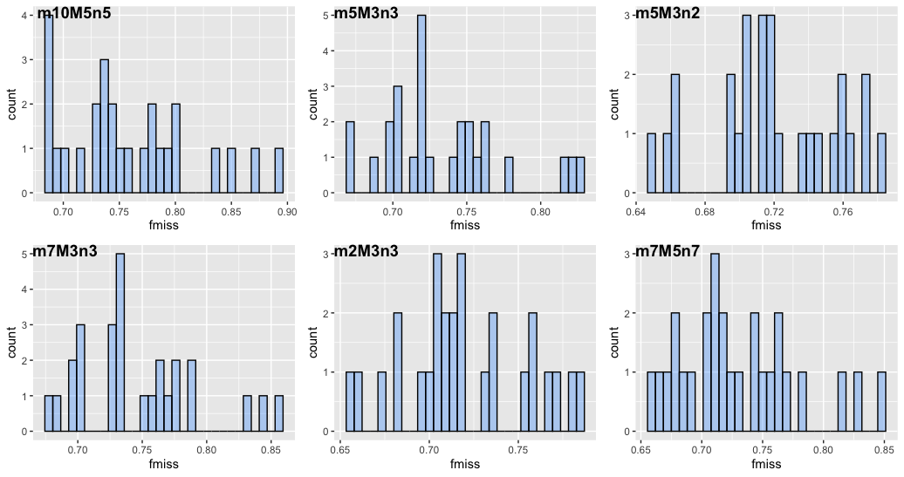
VCF tools Stacks using 6 different parameters
Proportion of missing data per individual:
Missingness on a per-individual basis = proportion of missing data per individual

Slide 37
VCF tools Stacks using 6 different parameters
Mean depth per individual

Slide 38
VCF tools Stacks using 6 different parameters
Minor allele frequency

Slide 39
Stacks – small dataset m7 – M5 – n7

Slide 40
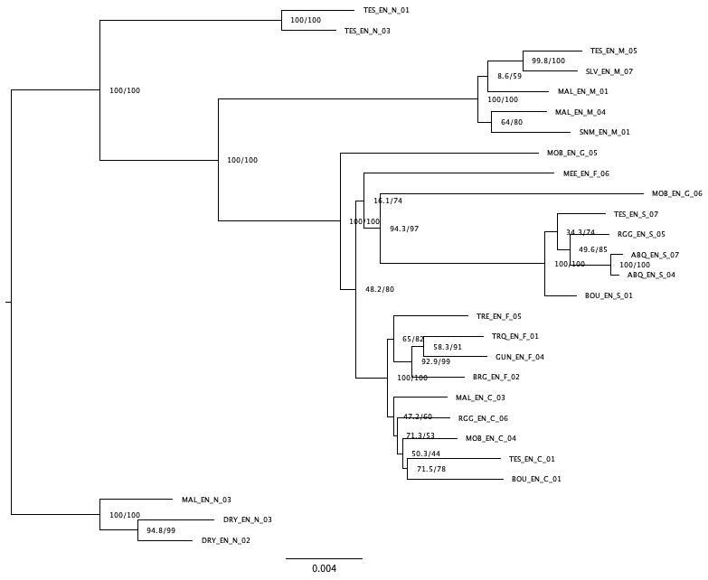
Stacks – small dataset m7 – M5 – n7
notata
marshmallow
goober
finial
goober
smooth
finial
cotton
notata

Slide 41
Reference based and Ipyrad

Slide 42
Reference based and Ipyrad
198 samples
Ipyrad
variant count: 963177
Still processing
Stacks reference based
Erigeron canadensis genome
variant count: 31163
variant count after filtering: 6852
131 samples after filtering
hard filter to minimum depth of 5, and minimum genotype quality of 30
max depth cutoff of 100
missing data in each sample = .70 (30%)

Slide 43
Reference based & ipyrad vcf tools
Variant missingness:
Missingness on a per-site basis. This is a measure of how many individuals lack a genotype at a call site.
Typically, missingness of 75-95% is used.
Mean depth:
Mean depth per site averaged across all individuals.
The number of reads that have mapped to this position (coverage). The more reads that cover a site, the higher confidence our base call is.

Slide 44
Reference based & ipyrad vcf tools
Proportion of missing data per individual
Missingness on a per-individual basis = proportion of missing data per individual
Mean depth per individual

Slide 45
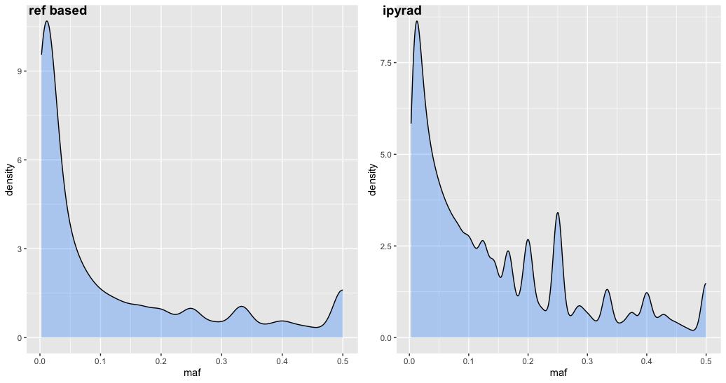
Reference based & ipyrad vcf tools
Minor allele frequency

Slide 46
Hard filter to minimum depth of 5, and minimum genotype quality of 30

Slide 47
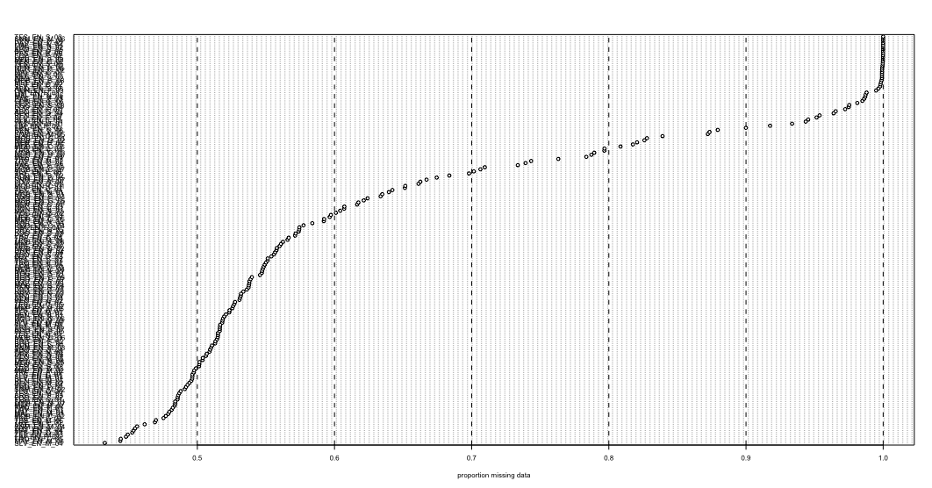
missing_by_sample(vcfR=vcfR, cutoff = .70)

Slide 48
PCA using reference-based assembly – PC1&2

Slide 49
PCA using reference based assembly – PC2&3
PC3&1

